Slide 1
A New Perspective to Multiple Internal Rates of Return
Group 9
20666501 Feng,Boqiao
20925426 Guo,Weiqi
20889385 Zhou, Sitian
20931401 Zhou, Yuxiang
20921341 He, Jiacheng
20888886 Wang, Jianhao

Slide 2
Background
In the traditional perception, multiple and non-existing internal rates of return are meaningless for investors to make decisions.
In this paper, Hazen proposes a new computational approach that enables us to use multiple IRRs to obtain conclusions consistent with net present value.

Slide 3
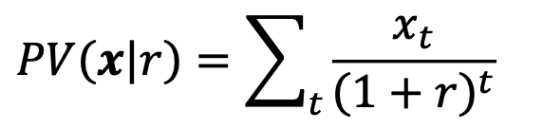

Introduction
Net Present Value (PV): For a finite or infinite cash flow sequence x=(x₀,x₁,...,x_{T}), the net present value of a such cash flow sequence at interest rate r is given by
Internal rate of return (IRR): IRR(x) is the set of all r that make be 0. (Denote each IRR as k to distinguish it from the market rate r)
For conventional cash flows, IRR will be unique. By comparing the unique IRR with market rate:
If IRR > market rate, then the investment is worthwhile;
If IRR < market rate, then the investment is not worthwhile.

Slide 4
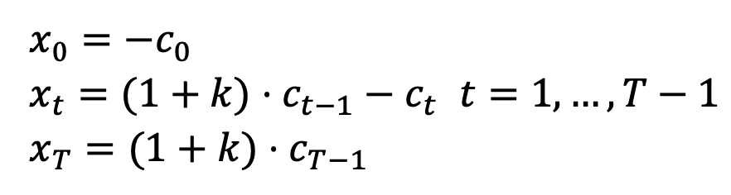
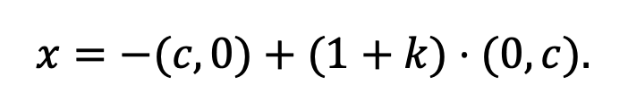
Introduction
Investment streams: Hazen defines that if the following equations hold:
then we can say that the investment streams c=(c₀,c₁,...,c_{T-1}) yields cash flow stream x=(x₀,x₁,...,x_{T}) at rate of return k. Such equations can also be written in vector form as:

Slide 5
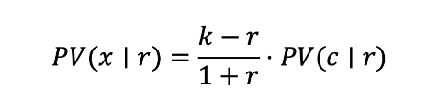
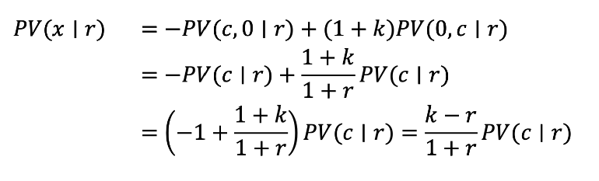
Theorem 1
If investment stream c=(c₀,c₁,...,c_{T-1}) yields x=(x₀,x₁,...,x_{T}) at constant per-period rate of return 𝑘, then for 𝑟 ≠ −1, we have
Proof:
We remove the 0 from PV(0,c|r), so we need to discount once to make sure the investment stream starts from t=0.

Slide 6
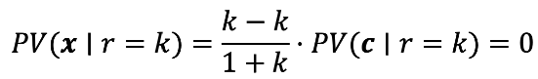
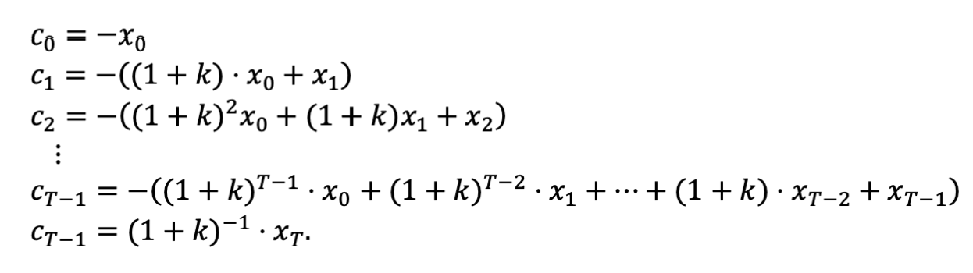
Theorem 2
The quantity k is an IRR for a cash flow stream x if and only if there exists an investment stream c that yields x at the constant per-period rate of return k.
Proof:
From Theorem 1 we have GGGGGGGG so k is the internal rate of return.
Conversely, from
we have
So if k is the internal rate of return for x, then c is an investment stream with per-period return k yielding x.
Notes:
The component c_{t} is the negative of the sum of the future value of cash flow from x₀ to x_{t} at time t with compounding rate r=k.

Slide 7





Theorem 3
If c is a pure investment, if and only if .
If c is a pure borrowing, if and only if .
Note:
c is a T dimensional vector c = (c₀,c₁,...,c_{T-1})
Stream c is a pure investment if and c has at least one positive element.
Stream c is a pure borrowing if and c has at least one negative element.

Slide 8
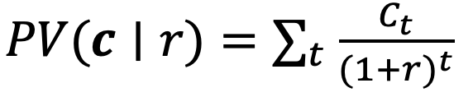
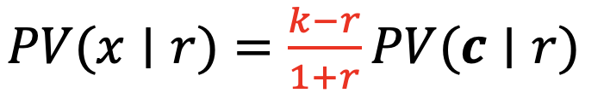

Theorem 3
Proof:
If stream c is a pure investment, and c has at least one positive element.
Also, by definition, we have
Thus, we can get ,
Based on above, the sign of is determined by the red part.
One can easily conclude that if and only if .
The pure borrowing case is similar as pure investment.

Slide 9




Theorem 4
Actually, the conditions in Theorem 3 that require investment streams are non-negative or non-positive is too strong, in fact we only need to consider that the sign of the is exactly negative
If , c is defined as net investment, then if and only if .
If , c is defined as net borrowing, then if and only if .
If , then .
Notes:
Note：
If c has both positive and negative elements, we can call it a mixed investments.

Slide 10
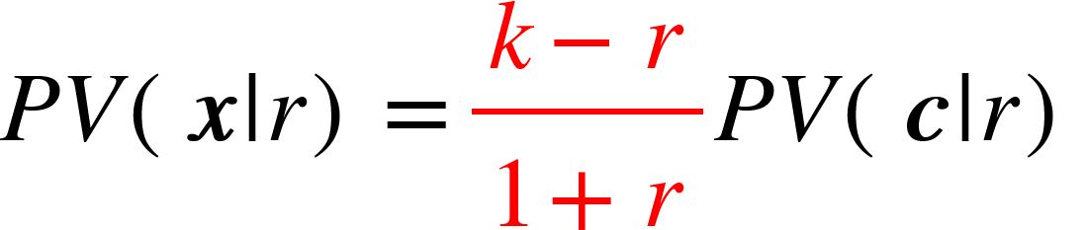






Theorem 4
Proof:
Recall: the sign of is determined by two parts:
the red part and since
1. If c is a net investing, we have . if and only if .
2. If c is a net borrowing, we have . if and only if .
3. If , then .
Remark:
It does not matter which internal rate k we use, as long as we examine the corresponding investment stream and compare the k with r in the above way.

Slide 11
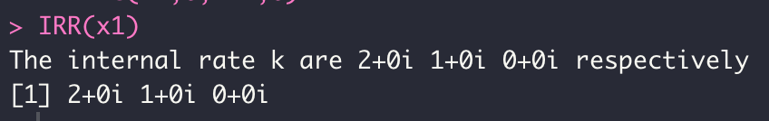
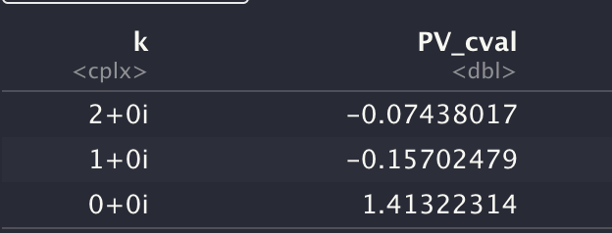


Example
Consider:
r=10%
Cash flow x1 = (-1, 6, -11, 6)
Cash flow x2 = (-1, 3, -2.5)
For cash flow x1,
Use the function IRR() to calculate k=0 or 100% or 200%.
For each k, we get the .
When k=0, , so c is net investment.
and because , so this project is “undesirable”.
When k=100% or 200%, , so c is net borrowing.
But , so this project is “undesirable”.
For cash flow x2, it is considered impossible to have IRR, but we will show that it is still possible to make a decision using IRR.
Notes:
From this example, we can see that all IRRs give the same result

Slide 12





Theorem 5
Suppose k is an IRR for cash flow x, and c is the corresponding investment stream. Considering the real part of c we have:
If ( is a net investment), then
if and only if .
If ( is a net borrowing), then
if and only if .
Notes:
For the proof and the case PV(Re(c)|r)=0, please refer to the paper.

Slide 13
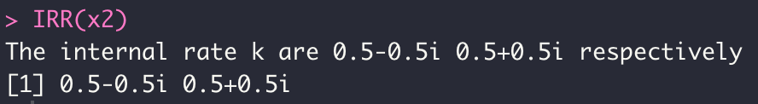
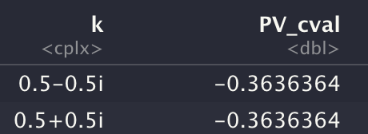


Example
Cash flow x2 = (-1, 3, -2.5), r=10%.
The IRRs are complex number.
Using Theorem 5, we calculate
instead of .
Both , so they are net borrowing. But , so this project is “undesirable”.
The result confirms to that of NPV.

Slide 14
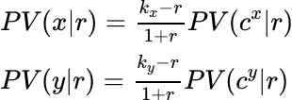




Comparing Competing projects
In this paper, it says that ranking cash flows of competing project by their internal rate of return may give results that conflict with net present value.
Supposed we have two cash flow x and y, then according to Theorem 1,
We can clearly find that only and are equal or their difference are very small, then the value ranking of cash flow x and y can be determined by the ranking of the internal rate ,

Slide 15
Comparing Competing projects
We need two projects to have similar so that we can compare them by internal rates.
If cash flow has multiple internal rates, it will have more than one investment streams and each of them correspond to one internal rate. So we need to find the that is closest to the of the other project.
If we can't find the similar between two projects, we directly compare the net present value of their cash flow .
In our program, we set the difference between of two projects to be no greater than 0.05. If it is, we compare directly.

Slide 16
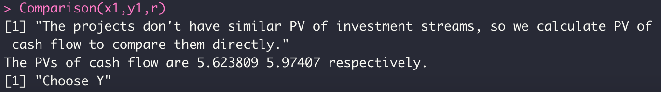
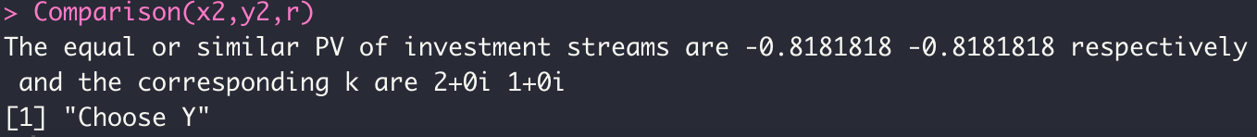
Example
Example 1: Two cash flows have very different net investment.
A: x₁ = (-20, 14, 10, 6, 2, -2), B: y₁ = (-20, -6, 1.1, 8.2, 15.3, 22.4)
Let r = 10% as market rate.The output is
Although the proper internal rate of B is 16.0% which is smaller than that of A at 28.3%, we choose B.
Example 2: Two cash flow have same net borrowing.
A: x₂ = (-1,5,-6), B:y₂ = (-1,4,-4)
Let r = 10% as market rate.The output is

Slide 17
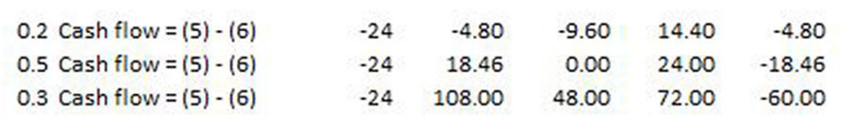
Example
We will explain an example from the paper Average Internal Rate of Return For Risky Projects. (r=6%, name the cash flows cf1, cf2, cf3 respectively)
The hypothetical cash flow has three states and we will make decision on each state.

Slide 18
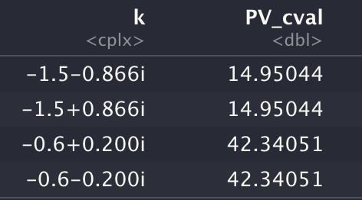
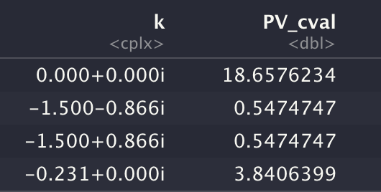
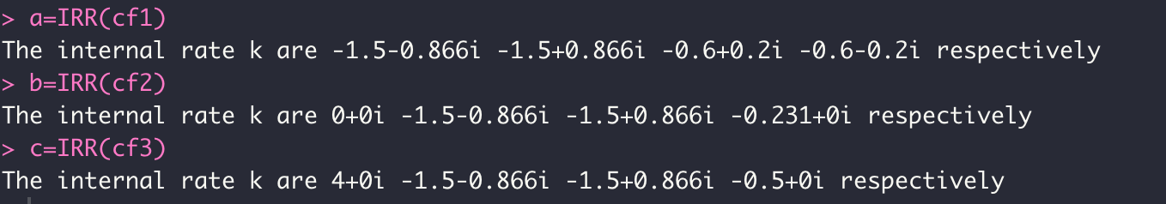
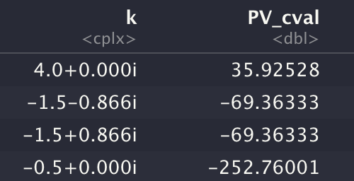
Example
The IRRs from these project covers complex, negative and proper cases.

Slide 19
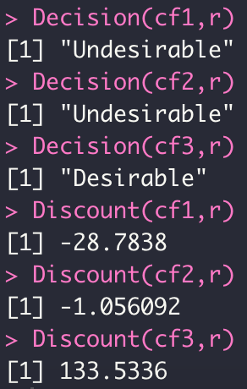

Example
We can see the decisions of our algorithm confirm to that of NPV. For the two “undesirable” cash flows, we perform the comparison of two projects and we get:

Slide 20
Limitation
Although the final result is consistent with the direct analysis by using PV, it is more complex to derive useful information from Hazen's method.
When we compare several projects by using multiple internal rates of return, it requires that the IRRs should correspond to the same or approximately the same net investments. However, this is not easy to achieve in practice.

Slide 21
Conclusion
From Hazen's point of view, we can convert the problem of multiple and complex-valued IRR into the problem of multiple investment streams. By analyzing each investment stream separately and determining whether it is a net investment or net borrowing, we can treat its IRR accordingly and derive valid conclusions from multiple IRR.
Although the problem of multiple IRR can be solved using Hazen's method, it does not mean that it is better to use IRR than other analysis methods, and there are still some limitations to using multiple IRR. Therefore, Hazen's method is more suitable for use as a complement to other methods like NPV.

Slide 22
Reference
Gordon B. Hazen (2003): Perspective on Multiple Internal Rates of Return, The Engineering Economist, DOI: 10.1080/00137910308965050
Gordon B. Hazen & Carlo Alberto Magni (2021): Average internal rate of return for risky projects, The Engineering Economist, DOI: 10.1080/0013791X.2021.1894284

